Slide 1
The perfect location
Always fresh

Slide 2
The case
Increased awareness towards health product
Every day necessity
Required fresh
Good products = happy customers

Slide 3
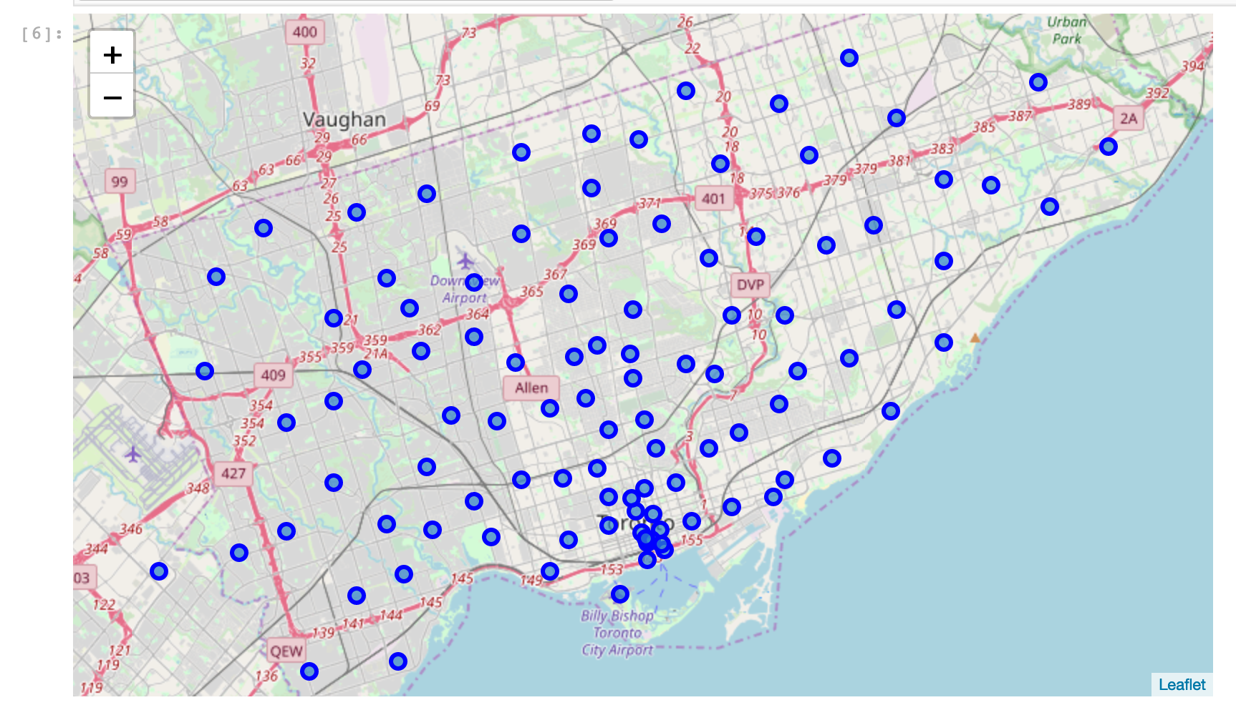
The problem
Location is the key

Slide 4
Solution
Traditional
AI base on data mining
Trial and error
Time consuming
Not guaranteed results
Educated decision
Fast and efficient
Flowless results

Slide 5
